Slide 1
Object Oriented Programming
2D Arrays , Indexers
&
Operator Overloading

Slide 2
Topics
2D Arrays
Indexer
Operator Overloading

Slide 3
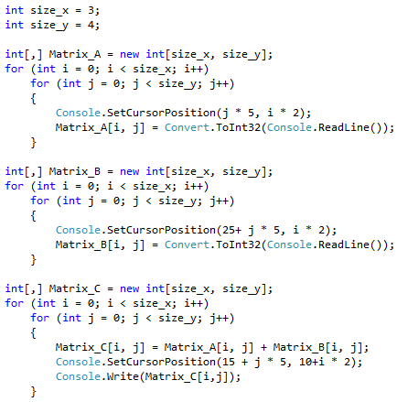
2 Dimensional Arrays

Slide 4
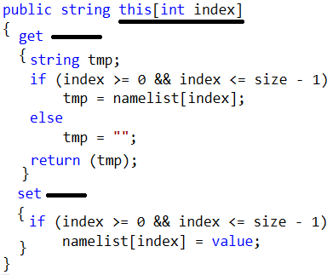
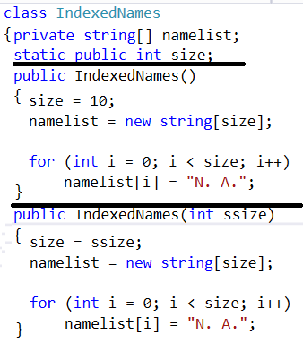
Indexers

Slide 5
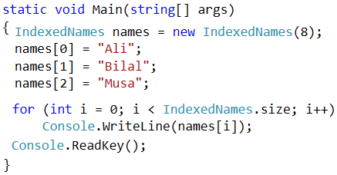
Indexers

Slide 6
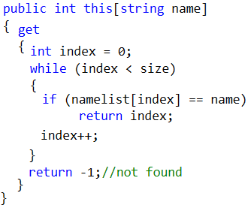
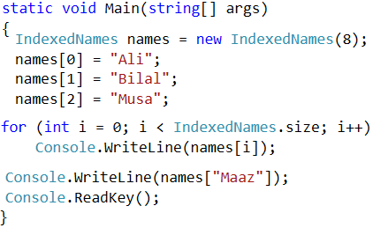
Overloaded Indexer

Slide 7
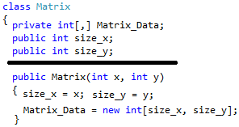

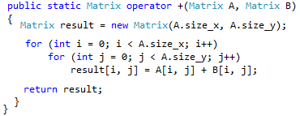
Operator Overloading

Slide 8
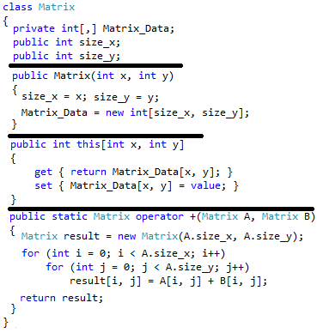

Slide 9
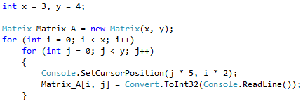

Operator Overloading

Slide 10
